Slide 1
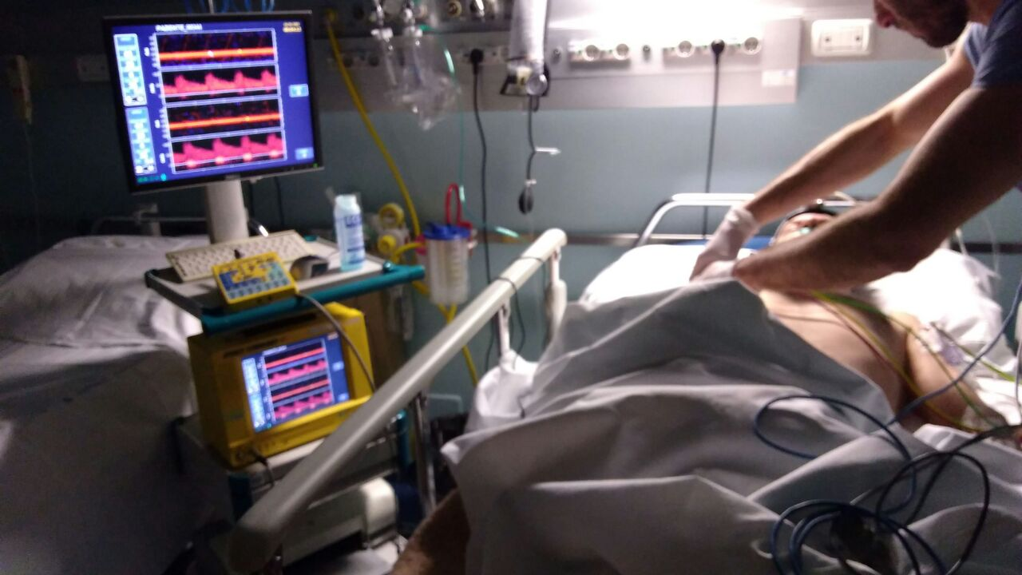
THE VALUE OF MICROEMBOLIC SIGNALS
AFTER ENDOVASCULAR STROKE TREATMENT
Claudio Baracchini MD, FESO
Director of the Stroke Unit and Neurosonology Lab
University of Padua School of Medicine, Italy

Slide 2
NO DISCLOSURES FOR THIS PRESENTATION
Notes:
I have no disclosures for this presentation.

Slide 3
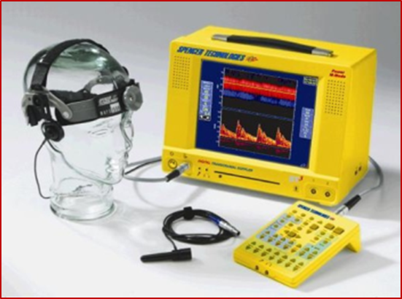
MICROEMBOLI DETECTION
Stationary TCD Monitoring
- 1 hour Monitoring -
MCA most frequently studied
MES detection also through the BA

Slide 4
MES Prevalence in Acute Stroke
The Prevalence of MES in Acute Stroke is very variable (range: 9.3-71%), due to:
different study populations*
monitoring time° (often beyond the first 24 hrs)
different drugs used (antiplatelets, anticoagulants, etc.)
*Stroke Type
MES +++ in Large Artery Disease
MES ++ in Cardioembolic Stroke
MES ± in Lacunar Stroke
° MES are more likely to be detected closer to the onset of symptoms, therefore TCD Monitoring should be performed early: <24hrs.

Slide 5
Limitations of MES Monitoring
Time consuming procedure.
Expertise required to analyze and interpret the recordings.
Lack of reliable systems for the studying the posterior circulation.
Lack of reliable automated systems for MES detection.
Lack of large, multicenter, prospective studies determining prognostic significance of MES.

Slide 6
MES and Stroke Risk
King, A. et al. Stroke 2009;40:3711-3717
Acute Stroke
MES+:  Stroke Risk (OR 2.44; 95% CI 1.17-5.08)
MES+:  Stroke/TIA Risk (OR 3.71; 95% CI 1.64-8.38)

Slide 7
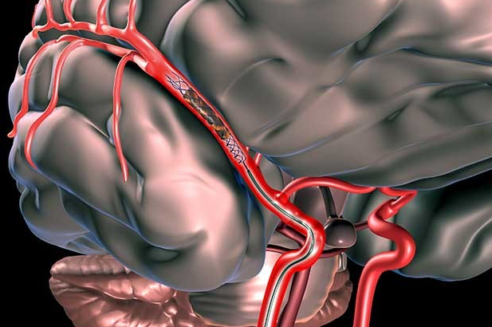
RECANALIZATION THERAPIES - thrombectomy, thromboaspiration -
Successful Recanalization rate (TICI 2b-3): ≈90%
Favourable outcome (mRS 0-2) at 90 days after EVT: ≈50%

Slide 8
Clinical Failure despite successful EVT
About 50% of patients do not experience clinical improvement despite successful recanalization.
Why this discrepancy between clinical outcome and recanalization rates?

Slide 9
RECANALIZATION - Necessary but not sufficient -
Each patient’s response to thrombectomy (± thrombolysis) depends on several factors:
flow capacity of collateral vessels
degree of chronic ischemic disease
ischemic preconditioning
oxidative stress tolerance
microvascular blood flow regulation
etc.

Slide 10
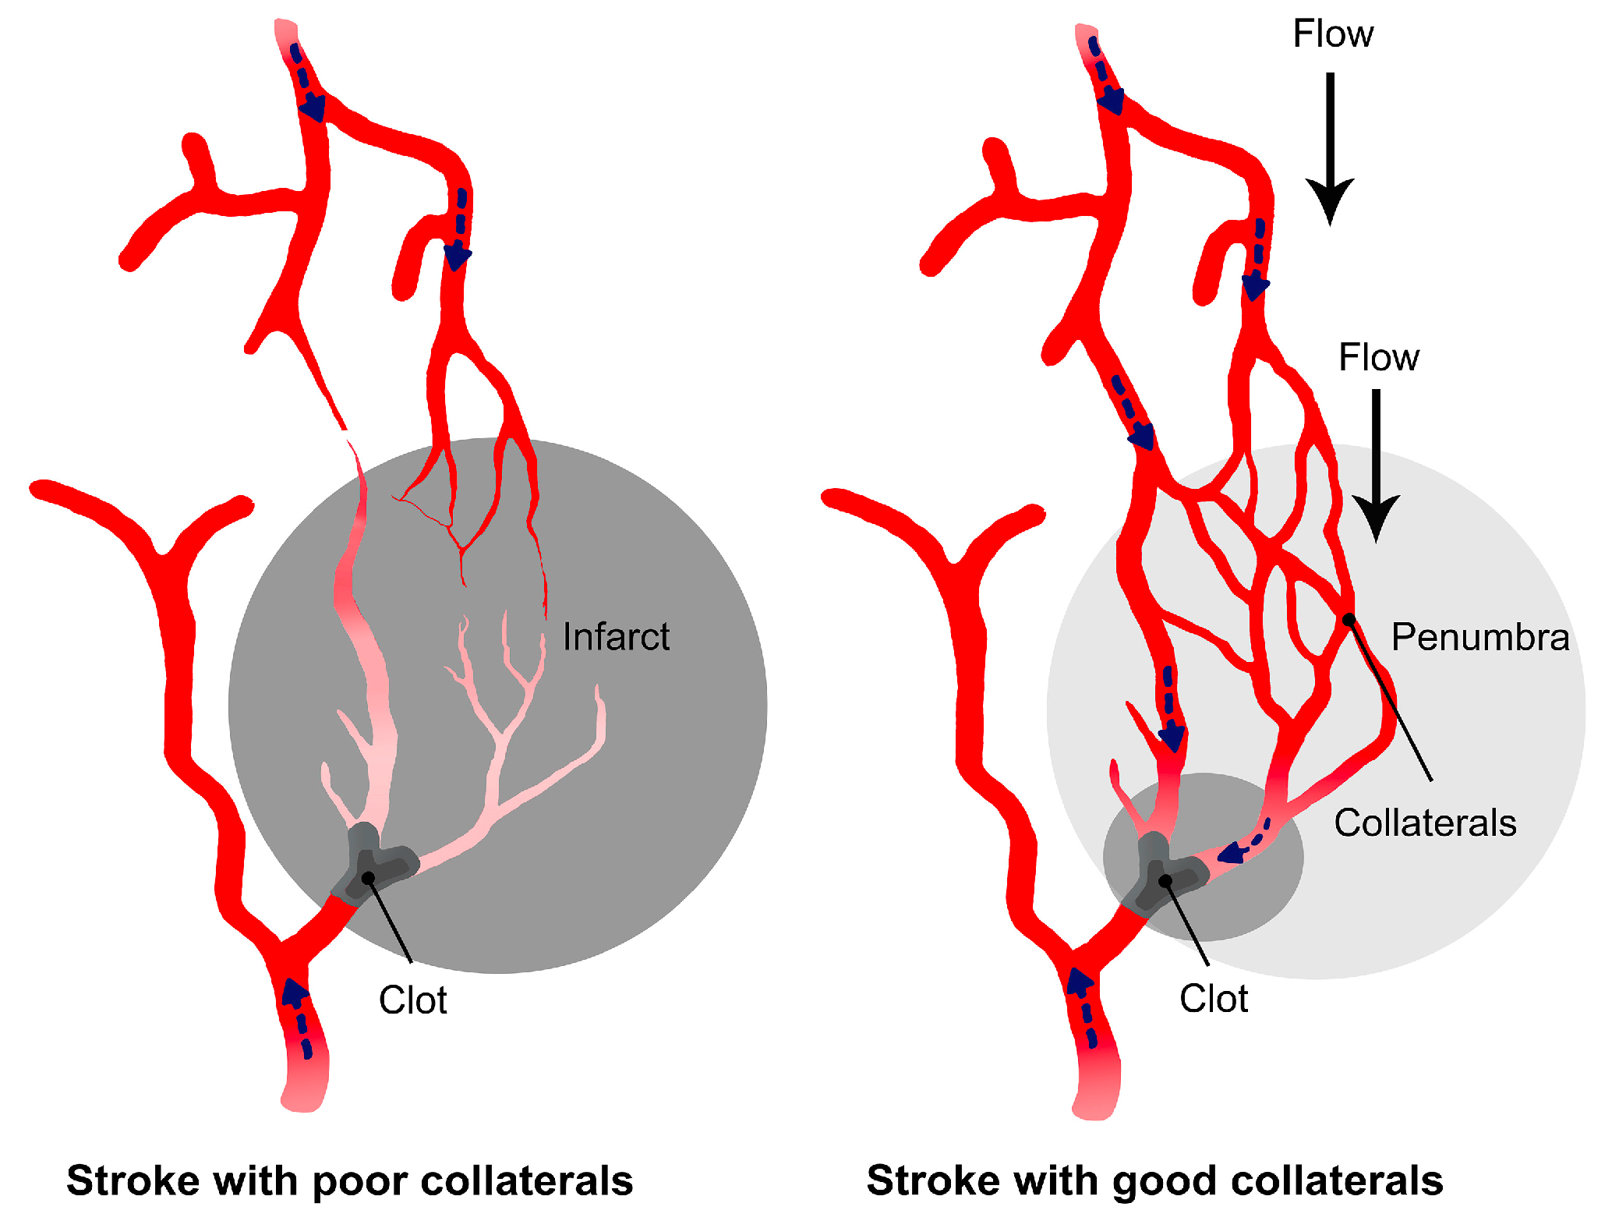
RECANALIZATION THERAPIES - thrombectomy, thromboaspiration -
Collateral flow is the basis for acute stroke treatment,
since neurons will only survive long enough to be rescued
with reperfusion therapies, if there is sufficient collateral flow.

Slide 11
Forest plot illustrating RR of good vs. poor pre-treatment collateral status
for successful recanalization.
Good pre-treatment collaterals may enhance the rates of successful reperfusion (RR 1.28, 95% CI 1.17–1.40; p < 0.001) and recanalization (RR 1.23, 95% CI 1.06–1.42; p = 0.006) in EVT for acute ischemic stroke.

Slide 12
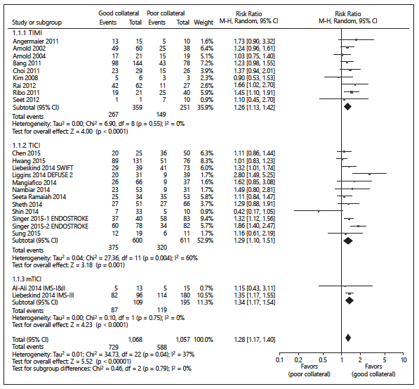
However, Poor collateralization does not explain
all outcome variability after EVT
Forest plot illustrating RR of good vs. poor pre-treatment collateral status
for successful reperfusion.

Slide 13
RECANALIZATION - Necessary but not sufficient -
Arterial Recanalization does not necessarily lead
to brain tissue Reperfusion

Slide 14
No-Reflow or No-Reperfusion
Hypotheses for this phenomenon include:
changes in the ultrastructure of the microvasculature and spontaneous blood clotting
capillary stalling and leukocyte adhesion
breakdown of the blood-brain barrier leading to tissue swelling and vessel collapse
vasoconstriction of the capillary vessels due to pericyte death
oxidative stress and inflammatory responses
microemboli

Slide 15
Why this discrepancy between clinical outcome and recanalization rates?
Hypotheses:
Procedural release of clot fragments
Distal embolization in the penumbra (occlusion of collateral vessels)
Distal embolization in a previously unaffected area (occlusion of microcirculation)
Embolization from same site causing the index stroke
Worsen the clinical outcome

Slide 16
Why this discrepancy between clinical outcome and recanalization rates?
Hypotheses:
Procedural release of clot fragments
Distal embolization in the penumbra (occlusion of collateral vessels)
Distal embolization in a previously unaffected area (occlusion of microcirculation: in 8.6% of the MR CLEAN study patients and 5.6% had clinical signs of a new ischemic stroke)
These clot fragments may be very small
and therefore they might not be detected with standard DSA

Slide 17
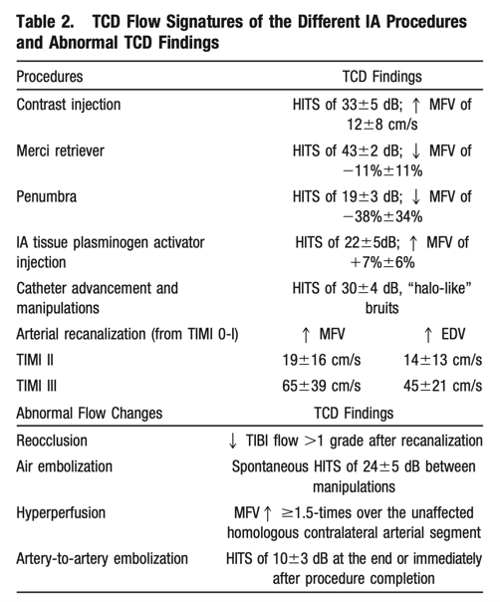
Continuous TCD monitoring during endovascular reperfusion procedures detected different types of flow changes : reocclusion, hyperperfusion, or artery-to-artery embolization that was typically accompanied by reformation of intraluminal thrombi.
In conclusion, TCD monitoring may be considered as a potentially useful technique for IA reperfusion assessment of acute ischemic stroke patients.
A prospective study is required to determine if TCD findings can predict harmful events and if acting on them during and soon after the procedures would improve outcomes after IA reperfusion.
Stroke 2010;41:695-699

Slide 18
TCD MONITORING FOR MICROEMBOLI
Hypothesis: Procedural release of clot fragments
Distal embolization in the penumbra (occlusion of collateral vessels)
Distal embolization in a previously unaffected area (occlusion of microcirculation)
Study Objectives:
assess the prognostic value of Micro-Embolic Signals (MES) after Thrombectomy.

Slide 19
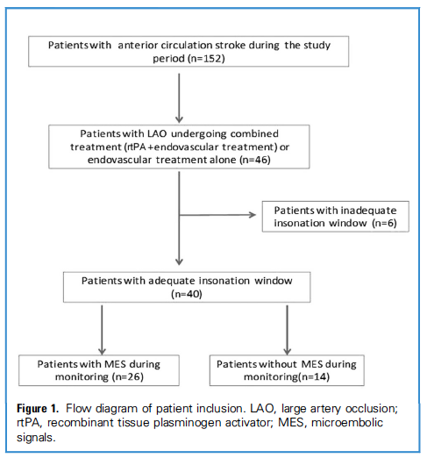
Study Period June 2016-January 2017
Eligible Patients
- ≥18 years of age
- First-ever acute ischemic stroke caused by
an anterior circulation LAO (occlusion of the TICA, M1-MCA, proximal M2-MCA])
- All patients undergoing EVT, with or without previous treatment with rtPA.
MES Detection
The presence and rate of MES were assessed by:
60 minutes of TCD bilateral Monitoring
Immediately (45 ±17.5 min) after thrombectomy.
Patients with ≥1 MES detected were assigned to
the MES-positive group.
World Neurosurg. 2018 Feb;110:e882-e889.

Slide 20
MES were detected in 65% (26/40)
of EVT-treated patients.
Range of MES Frequency | 1-35/h
Bilateral MES | 7/26 (26.9%)
Pts with ≥ 5 MES/h | 8/26 (30.7%)
World Neurosurg. 2018 Feb;110:e882-e889.

Slide 21
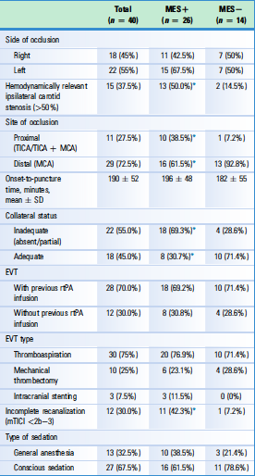
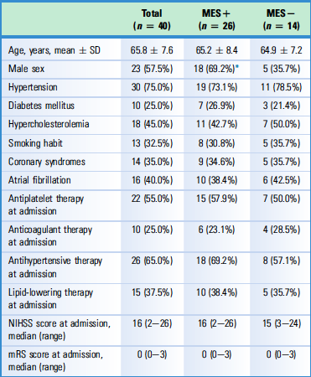
Vascular Status and Therapeutic Procedures
Performed in Acute Phase
Demographic and Clinical Characteristics
of Study Population at Admission
World Neurosurg. 2018 Feb;110:e882-e889.

Slide 22
FACTORS ASSOCIATED WITH MES
 | Univariate Analysis [OR (95% CI)] | Multivariate Analysis [OR (95% CI)]
Gender: Males | 4.05 (1.02-16.0); p=0.05 | 3.38 (0.96-18.23); p=0.12
>50% ipsilateral carotid stenosis | 6.01 (1.11-32.2); p=0.05 | 2.71 (1.07-14.2); p=0.05
Proximal occlusion | 4.12 (1.05-28.3); p=0.04 | 3.73 (1.02-26.5); p=0.05
Incomplete recanalization | 9.53 (1.08-54.4); p=0.03 | 9.01 (1.22-50.3); p=0.03
No or Inadequate collaterals | 4.05 (1.02-16.0); p=0.04 | 4.62 (1.14-16.3); p=0.04

Slide 23
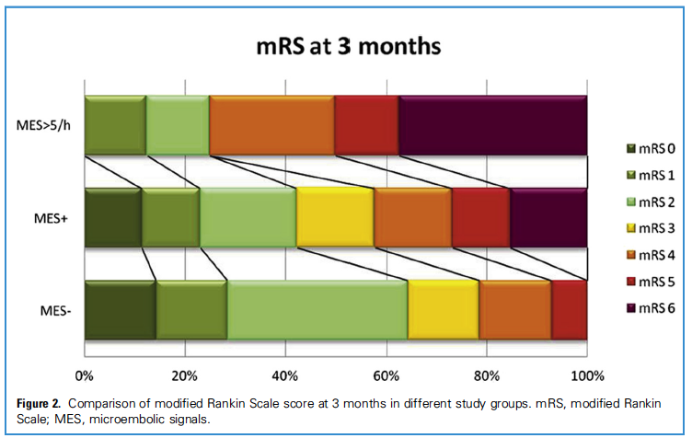
*
*
Pts with high MES rate (≥5/h) had a worse prognosis, both in terms of mortality (p=0.02) and in terms of disability (mRS≥3, p=0.03).

Slide 24
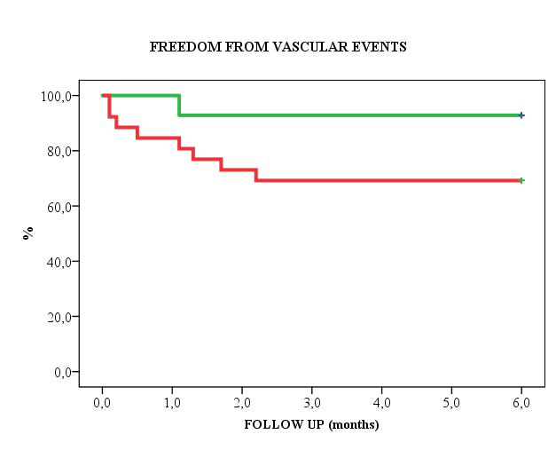
MES -
MES +
MES+ patients have a significantly higher incidence of vascular events (cerebral, cardiac, peripheral)
All early recurrencies (< 2 weeks)
occurred in MES+ group (2 ischemic strokes and 1 TIA).

Slide 25
NEURORADIOLOGICAL FOLLOW UP
MES+ patients had a significantly higher number of recent ischemic lesions outside the major ischemic area compared with MES- patients [4.6 ± 1.2 vs 0.8 ± 0.5, p = 0.02].
These lesions were distributed:
not only downstream to the occlusion site (73.4%)
but also in other vascular territories (26.6%)
- mostly (65%) in border zone areas.

Slide 26
TCD MONITORING AT 2 WEEKS
20* out of 26 pts underwent a second TCD monitoring after 2 weeks from the beginning of antithrombotic therapy
* 4 pts died and 2 were transferred to another hospital
A significant reduction in MES frequency was observed after 2 weeks in both groups (55.2% vs 65.4%), with no final residual difference.

Slide 27
MES REDUCTION WITH ANTITHROMBOTICS
 | Number of Pts (% pts monitored) | ∆ MES reduction (±DS)
No therapy ➔Antiplatelets | 9 (45.0%) | - 48.7 (±7.2)
No therapy ➔ NOACs | 5 (25.0%) | - 68.2 (±12.5)
Antiplatelets ➔ NOACs | 3 (15.0%) | - 42.7 (±9.4)
Warfarin ➔ NOACs | 3 (15.0%) | - 50.5 (±7.6)
A significant MES reduction was observed in all patients
(mean reduction: 55.3%), more noticeable with NOACs.

Slide 28
World Neurosurg. 2018 Feb;110:e882-e889
STUDY CONCLUSIONS
MES monitoring in stroke patients after EVT:
provides useful prognostic information
sheds light on the lack of clinical improvement despite successful recanalization
might guide medical treatment in higher risk patients (DOACs?)

Slide 29
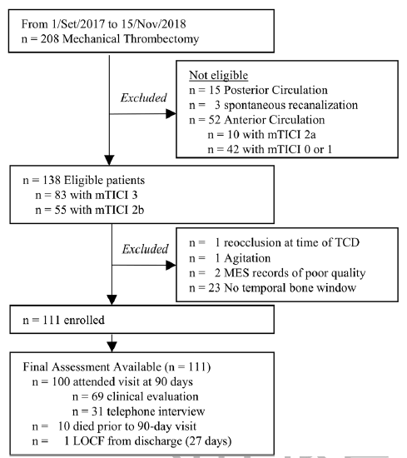
Eligible Patients
- Large vessel occlusion of the proximal MCA
(main trunk or first-order branch) or TICA
- ≥18 years of age
- mTICI Grade 2b-3 after thrombectomy
MES Detection
The presence and rate of MES were assessed by:
30 minutes of TCD bilateral Monitoring
within 72 hours of thrombectomy.
Patients with ≥1 MES detected were assigned to
the MES-positive group.
Stroke 2020;51:154-161

Slide 30
RESULTS
MES Rate: 43 of 111 patients (39%).
MES Range: 1-21 counts/h
MES Median: 4 counts/h
Bilateral MES: 23%
MES rate and Stroke Subtype:
69% in symptomatic carotid stenosis
31% in cardioembolism
Stroke 2020;51:154-161

Slide 31
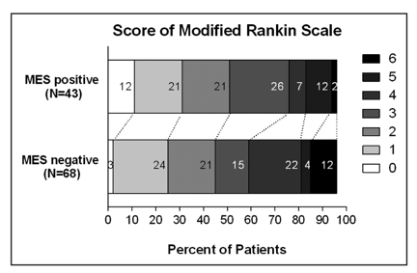
RESULTS
MES did not predict functional outcome after stroke nor the final infarct volume at 24 hours after thrombectomy.
Stroke 2020;51:154-161

Slide 32
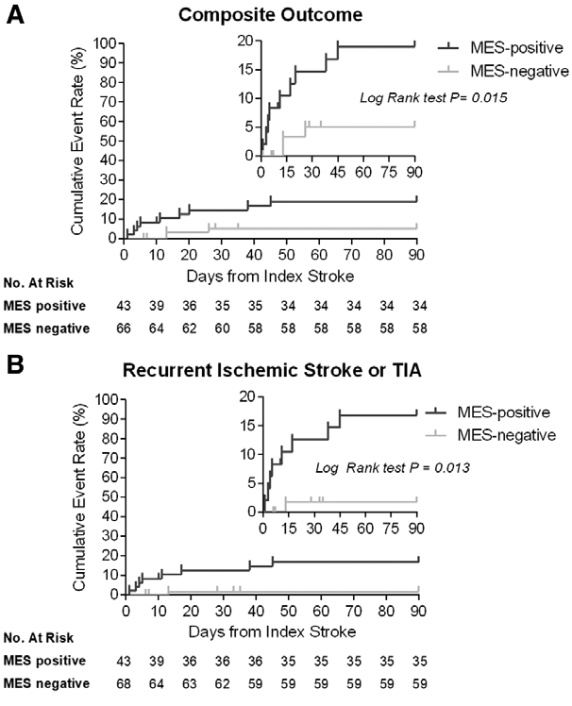
*
* ischemic stroke, TIA, systemic embolism.
RESULTS
The presence of MES increased the risk of:
- recurrent ischemic stroke
- systemic embolization
by 6- to 8-fold during 90 days of follow-up.
Kaplan-Meier survival curves for event recurrence
within 90 days from index stroke.
Stroke 2020;51:154-161

Slide 33
THE VALUE OF MES DETECTION
AFTER ENDOVASCULAR STROKE TREATMENT
to identify patients with worse prognosis.
to identify patients with higher risk of recurrent embolic events
This has several implications:
risk stratification
patient management (better antithrombotic therapy)
identification of safer methods of recanalization (preventing iatrogenic embolization)

Slide 34
THE VALUE OF MES DETECTION
AFTER ENDOVASCULAR STROKE TREATMENT
Lack of reliable automated systems for MES detection in the anterior and posterior cerebral circulation
Lack of large, multicenter, prospective studies determining prognostic significance of MES.
Claudio Baracchini MD, FESO
President of the ESNCH

